Slide 1
Air Travel – Safety and Fatalities
Is Air Travel safe?

Slide 2
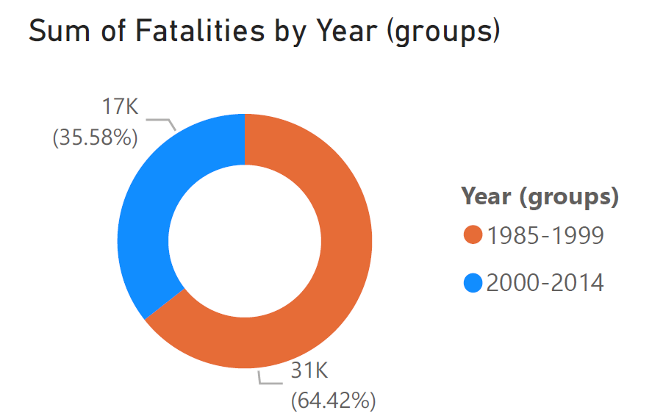
Fatalities by Years

Slide 3
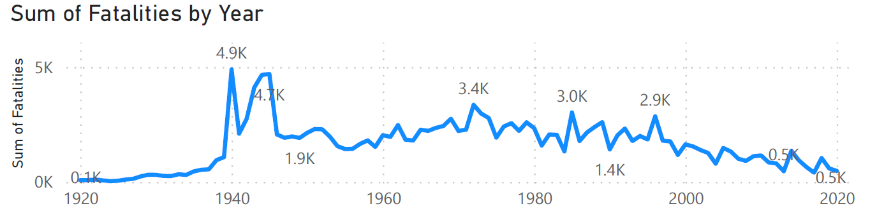
Fatalities by Year (Continue)

Slide 4
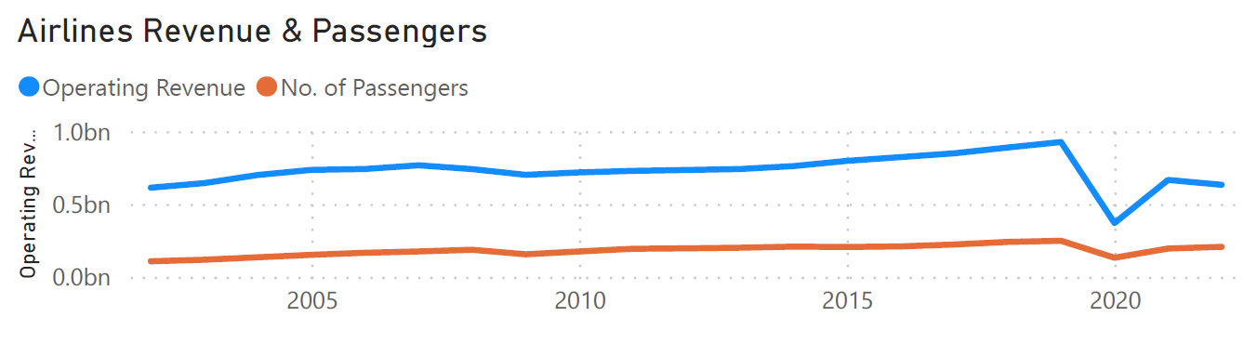
Passengers and Revenue Growth

Slide 5
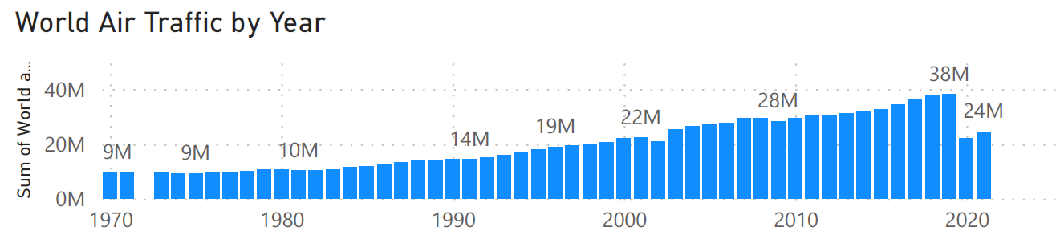
Air Traffic Growth by Year

Slide 6
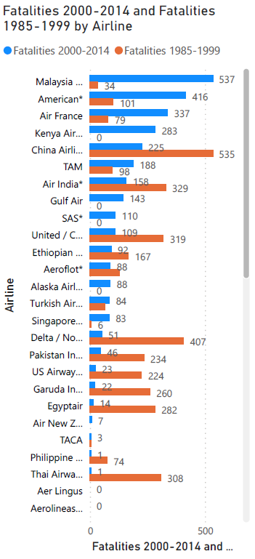
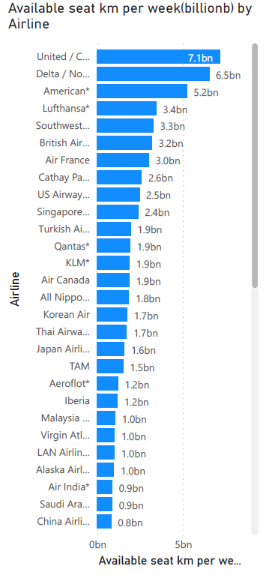
Fatalities by Each Airlines between 2 eras
Distance Travel per week by Airlines

Slide 7
United Airlines Stats
109 Fatalities since 2000
7 billion km per week

Slide 8
Sources
Death Rate per Year Retrieved from Bureau of Aircraft Accidents Archives: http://www.baaa-acro.com/statistics/death-rate-per-year?page=0
Airline Safety. Retrieved from Github - fivethirtyeight: https://github.com/fivethirtyeight/data/tree/master/airline-safety
Operating Revenue (In Thousands of Dollars) Retrieved from Bureau of Transportation Statistics: https://www.transtats.bts.gov/Data_Elements_Financial.aspx?Data=7
Passengers All U.S. Carriers - All Airports. Retrieved from Bureau of Transportation Statistics: https://www.transtats.bts.gov/Data_Elements.aspx?Data=1
Color Palette Reference:
How to Use Color Blind Friendly Palettes to Make Your Charts Accessible. Retrieved from Venngage: https://venngage.com/blog/color-blind-friendly-palette/#3

Slide 9

Have a safe Flight!

